Slide 1
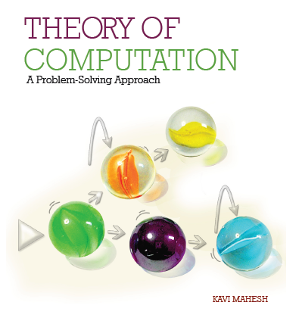

Theory of Computation: A Problem-Solving Approach
Chapter – 10: Turing Machines

Slide 2
Learning Objectives
Learn how a simple computing machine can compute anything that is computable.
Learn to construct simple Turing machines for languages and computable functions.
Learn techniques for constructing more complex Turing machines.
Understand how variations of Turing machines are all equivalent.
Learn how to compile a Turing machine into a binary string.
Understand how a universal Turing machine works as a stored-program computer.

Slide 3
The Idea of a Universal Computing Machine
In 1928, David Hilbert had posed a grand challenge known as Entscheidungsproblem or the decidability problem.
In 1931, Kurt Gödel proved his famous incompleteness theorem which showed that any formal mathematical system necessarily had statements that could neither be proved nor disproved.
In 1936, Alan Turing proposed a universal computing machine now known as the Turing machine to show why the incompleteness exists, or, why not everything is decidable.
The Turing machine can compute anything that is computable.
It is thus more powerful than DFA or PDA.
It is essentially a DFA endowed with a memory unit in the form of an infinitely long tape with a linear sequence of memory cells.

Slide 4
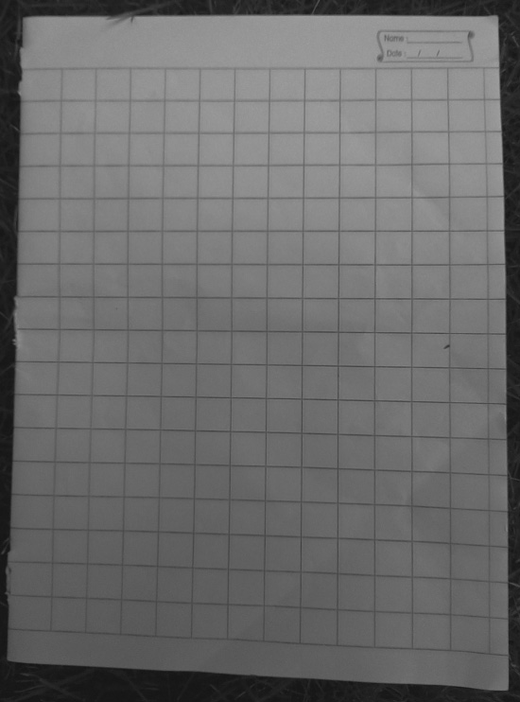
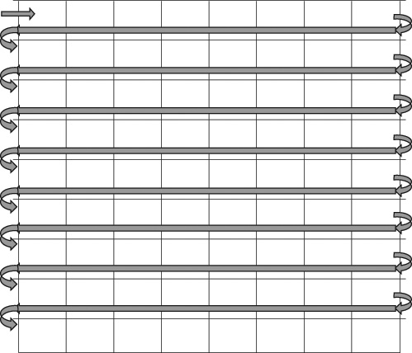
Why Tape Memory?
Unlimited size: can solve problems of any size
Sequential access: keeps instruction set to a minimum
Similar to a two-dimensional grid of a mathematics worksheet but in just 1 dimension

Slide 5
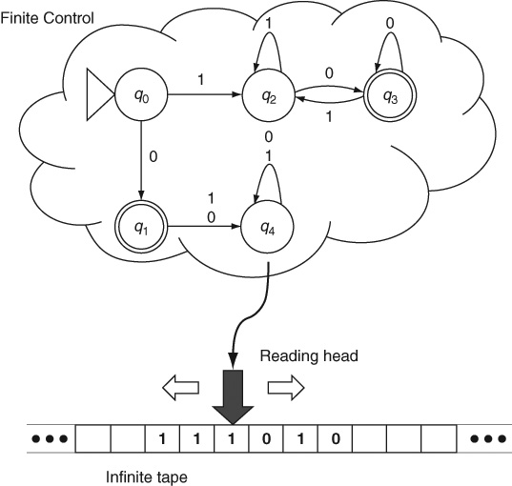
Turing Machine

Slide 6
Turing Machine Operation
Instructions:
Read the symbol at the current cell
Write a new symbol at the current cell
Move left
Move right
Turing machines can produce two kinds of outputs:
they can actually compute a result from the input string and write the result on the tape, or,
if a possible result of a computation is given as a part of the input, they can give us a Boolean answer by halting either in a final or non-final state of the automaton, thereby indicating whether the given input is true or false or whether the given result is correct or not.

Slide 7
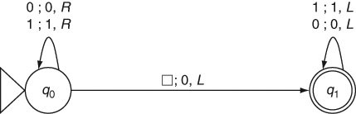
Turing Machine: Example 10.1
To double a given binary number

Slide 8
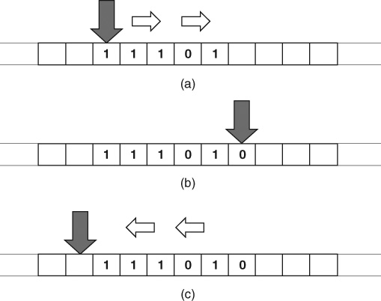
Example 10.1: Tape Contents

Slide 9
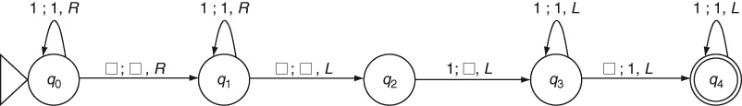
Adding Unary Numbers: Example 10.2

Slide 10
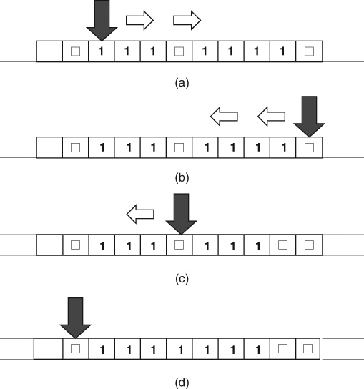
Example 10.2: Tape Contents

Slide 11
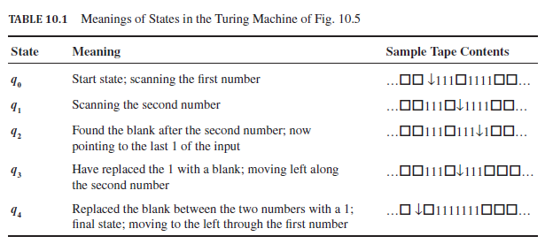
Example 10.2: Meanings of States

Slide 12
Turing Machine: Definition
A Turing machine M has five elements:
M.alphabet: Denoted by Σ, the tape alphabet is the set of symbols used to write input, output and intermediate strings on the tape.
M.states: Also denoted by Q, it is the set of all states in the automaton.
M.startState: Usually denoted by q₀, it is the start state of the automaton in the control unit.
M.finalStates: Denoted by Q_{F}, it is the subset of M.states that are final states of the automaton.
M.transitionFunction: It is a function δ from Q X Σ to Q X Σ X {Left, Right}, that is, a mapping from the current state and the current symbol under the reading head on the tape to a new state, a new symbol in the cell and a movement of the reading head by one cell to the left or to the right.

Slide 13
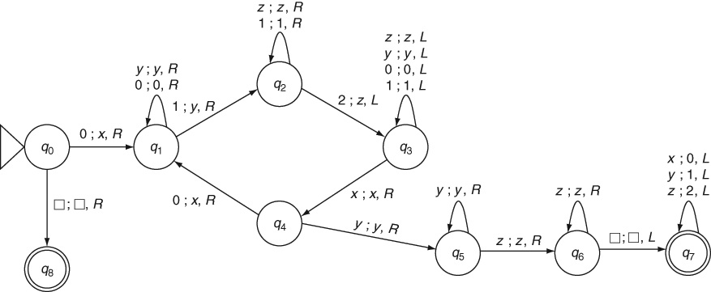
Complex Turing Machine: Example 10.3
A language that is not context-free: 0^{n}1^{n}2^{n}

Slide 14
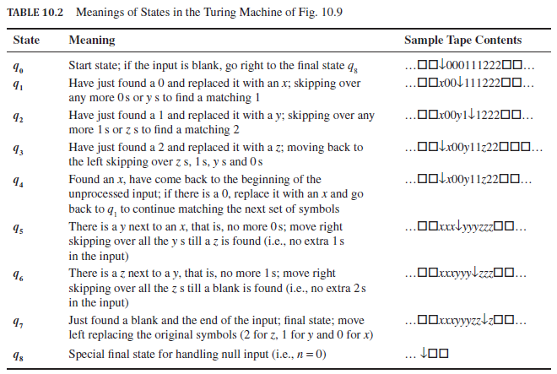
Example 10.3: Meanings of States

Slide 15
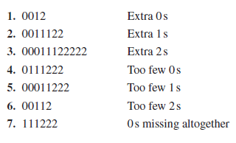
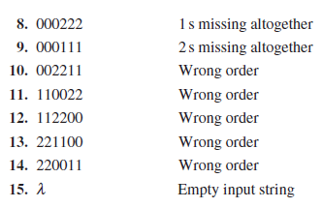
Example 10.3: What does it Reject?

Slide 16
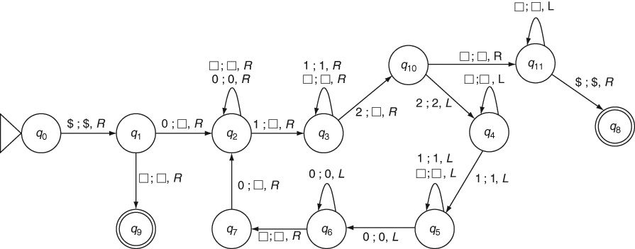
Another Turing Machine: Example 10.3

Slide 17
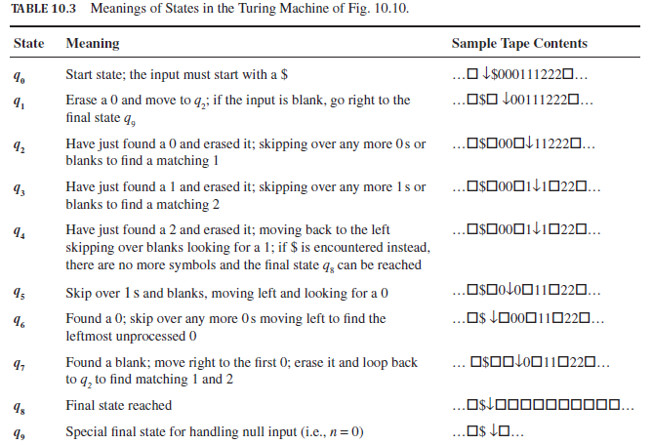
Meanings of States: Example 10.3

Slide 18
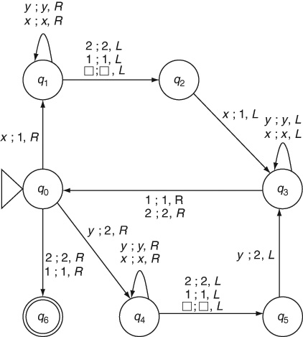
Turing Machine: Example 10.4
The language of even palindromes ww^{R}

Slide 19
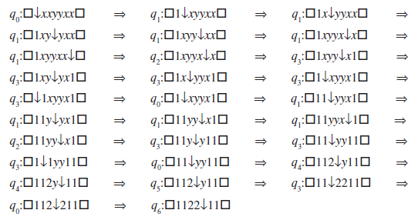
Turing Machine: Example 10.4 (contd..)
How it accepts xxyyxx

Slide 20
Turing Machine: Example 10.5
Algorithm for processing ww
Mark the midpoint by right-shifting the entire second half of the string by one cell. Its algorithm is:
Mark a symbol at the left of the first string w (q₀-q₁).
Go till the end of the string (q₁–q₂).
Right-shift the rightmost symbol of the second string w (q₂–q₃/q₅–q₄).
Come back to the left and repeat (q₆-q₀).
Match the two halves:
Come back from the midpoint to the beginning of the first string (q₇).
Insert a special symbol $ to mark the start of the first string (q₇–q₈).
Erase a symbol (0 or 1) at the left of the first string (q₈–q₉ or q₈–q₁₁).
Skip over to the right until a matching x or y is found and erase it (q₉–q₁₀ or q₁₁–q₁₀).
Come back to the first part skipping over blanks (q₁₀–q₁₃).
If there are more symbols in the first half, come back to q₇ and continue looping.
Else go to the final state q₁₂.

Slide 21
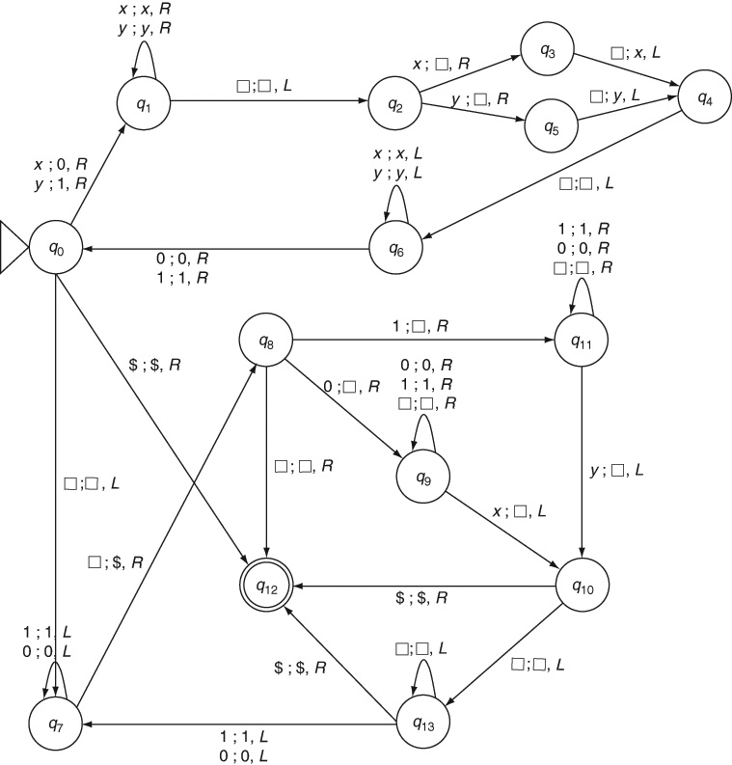
Turing Machine: Example 10.5

Slide 22
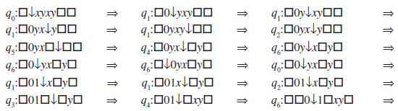
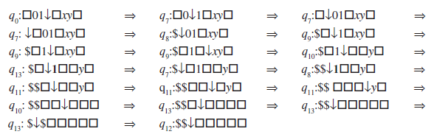
Example 10.5: Trace
For input xyxy

Slide 23
Mantras for Turing Machines
Find a good algorithm for the given problem before adding circles, arrows and loops to the state transition diagram of your Turing machine.
Consider the simplest string in the language and construct a Turing machine to accept that string.
Consider various exceptions and boundary conditions and verify that each one is satisfied, the null input λ in particular.
Consider the complement of the language, that is, strings that are not in the language and ensure that they are all rejected.
Analyze the intermediate tape contents and outputs to test the accuracy of the machine.

Slide 24
Mantras for Turing Machines (contd..)
Ensure that the machine does not run off to the left or right ad infinitum looking for a non-existent symbol. Consider inserting special markers such as $, < or > to prevent such a run off. Incidentally, this is similar to ensuring the terminating condition of a loop in a program.
Ensure that the machine halts for every possible input. For some problems, this will turn out to be impossible as we will see in Chapter 12.
State precisely the meaning of each state in the machine. If it is difficult to explain the meaning of a state concisely, its status in the design of the Turing machine is questionable.
Trace the execution of the Turing machine for a variety of inputs by going through the successive configurations in detail.

Slide 25
The Idea of Computation
The very idea of computation is defined as a series of moves or transitions that a Turing machine makes when given an input until it halts in some configuration (whether in an accepting state or otherwise).
A computable function is a function that a Turing machine can compute.
Most functions with which we are familiar are in fact computable. In other words, it is possible to construct a Turing machine for most functions that are of interest to us.
An algorithm is defined simply as a Turing machine that does not go into an infinite loop for any inputs. In other words, an algorithm is a Turing machine that computes a function and halts in some configuration for all inputs in the domain.
Church-Turing Thesis: everything that is computable is computable by a Turing machine.

Slide 26
Universal Turing Machine
A Universal Turing Machine is a “programmable” machine that can compute anything that is computable
A universal machine M_{U} should be able to simulate the computation carried out by any hardcoded Turing machine M.
The universal Turing machine M_{U} has three tapes:
The input-output tape is used to simulate the tape of the particular machine M (or computable function) which it is simulating. The input as well as any output is written on this tape.
The compiled program tape stores “the program,” that is, the table of instructions or an encoding of the transition functions of the Turing machine M which it is simulating. This tape is a read-only tape.
The working memory tape, on which the current state of the machine M being simulated is maintained, along with any working memory (i.e., scratchpad) it needs.

Slide 27
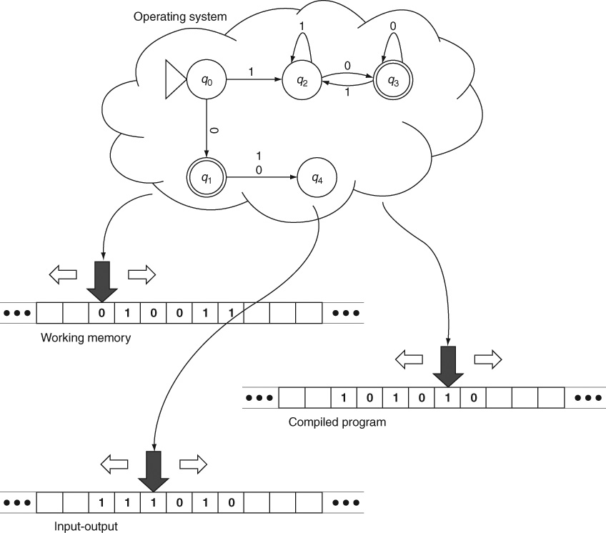
Universal Turing Machine

Slide 28
Working of a Universal Turing Machine
Look up the current state information maintained in working memory and the current symbol on the input-output tape.
With these two, scan the compiled program tape to find a transition for the given state and current symbol.
Execute the transition, that is, write the new symbol on to the input-output tape and move its reading head to the right or left as specified in the transition; note the new state mentioned in the transition in the working memory.
Repeat these steps until there are no more transitions in the compiled program.
When it halts, if the current state is a final state in the machine M being simulated, then the input is accepted; otherwise the input is rejected.

Slide 29
Binary Encoding of a Turing Machine
Standardize all elements of the Turing machine M except its transition function – let us assume that the alphabet is always {a₁, a₂, a₃, …}; that its states are always numbered q₁, q₂, q₃, etc. where q₁ is always the start state and q₂ is always the single final state.
Each transition from the state q_{i} with current symbol a_{j} going to state q_{k} and new symbol on the tape a_{l} with the reading head moving left (L) or right (R), that is, (q_{i}, a_{j}) → (q_{k}, a_{l}, R/L) is encoded as a sequence of numbers (i, j, k, l, 1/11) where 1 stands for R and 11 for L. This sequence can be encoded as unary numbers separated by a single 0. For example, the transition (q₃, a₁) → (q₄, a₂, R) would be encoded as 111010111101101.
Each such encoding of a transition in M can be padded by two 0 s on either side, for example, as 0011101011110110100 and the encodings of all the transitions can be concatenated to create a single binary string that represents the entire Turing machine M. The resulting string is a compiled program or executable binary program of the machine M.

Slide 30
Theorems
Theorem 20: Equivalence of Variations of Turing machines: Turing machines with stay-option, multi-track tape, semi-infinite tape, multi-tape, multi-dimensional tape, nondeterministic Turing machines are all equivalent to standard Turing machines.

Slide 31
Key Ideas
The Turing machine is a simple, abstract computing machine that can compute anything that is computable. In particular, Turing machines are the first kind of computing machines that we have seen which can accept languages that are not context-free.
The Turing machine is a finite automaton with a tape memory of unlimited size. Memory cells are accessed by a reading head that moves sequentially along the tape. The tape serves as a working memory for the automaton.
The input to a Turing machine as well as its output is written on the same tape. Unlike other automata, a Turing machine can process its input string in any order, not just left-to-right in a single pass.
A computation is defined as a series of moves or transitions that a Turing machine makes when given an input until it halts in some configuration (whether in an accepting state or otherwise).

Slide 32
Key Ideas (contd..)
A computable function is a function that a Turing machine can compute. Most functions with which we are familiar are computable. In other words, it is possible to construct a Turing machine for most functions that are of interest to us. However, Turing machines are not unique for a given function. There can be more than one machine (or table of instruction) for computing the same function.
An algorithm is a Turing machine that computes a function and halts in some configuration for all inputs in the domain of the function.
Fortunately, there are algorithms for most practical problems. For some problems though, Alan Turing showed that all computing machines suffer from the halting problem, a limitation of computing.
Alan Turing and Alonzo Church independently showed that anything that can be computed can be computed by a Turing machine. No one so far has been able to find a computing model that can compute things that Turing machines cannot. Hence this claim is known as The Church-Turing Thesis.

Slide 33
Key Ideas (contd..)
All variations of the standard Turing machine are equivalent to it. Multi-track, multi-tape, multi-dimensional, semi-infinite, non-deterministic and stay-option Turing machines are all equivalent to the standard machine. They cannot compute anything that is not computable by the standard Turing machine.
We can use a multi-tape machine to design a universal Turing machine that can simulate the computation of any other Turing machine.
A Turing machine whose computation is to be simulated by the universal machine is first encoded as a binary string. This is equivalent to compiling a program into executable code.
Turing’s universal machine is the basis for all modern stored-program computers that load an executable program into memory and then run the program. This way, the universal Turing machine can compute anything that any other Turing machine can.
Although there is no algorithm to design a Turing machine, the set of mantras discussed in this chapter help us in designing an accurate Turing machine for a given problem.

Slide 34
End of Chapter 10

